Slide 1
Python Advanced Python Scripting
Module - 2
Presentation By
Mohammed Tahir Mirji
MTech CS

Slide 2
CONTENTS
Write & run scripts locally
Work with raw input from users
Read and write files
Handle File error
Import Local scripts
Reading and loading text, csv data files using python
Using Modules from standard library & third party
Debugging python code
Understanding packaging of python code to EXE
Assignments
Code Examples Github Link

Slide 3
Write & run scripts locally
The most basic and easy way to run a Python script is by using the python command. You need to open a command line and type the word python followed by the path to your script file,
Ex: python first_script.py

Slide 4
Work with raw input from users
Python provides us with two inbuilt functions to read the input from the keyboard.
input()
raw_input() functions in Python

Slide 5
Work with raw input from users
input() function
Python input() function is used to take the values from the user. This function is called to tell the program to stop and wait for the user to input the values. It is a built-in function.
In Python 3.x, the input function explicitly converts the input you give to type string. But Python 2.x input function takes the value and type of the input you enter as it is without modifying the type.

Slide 6
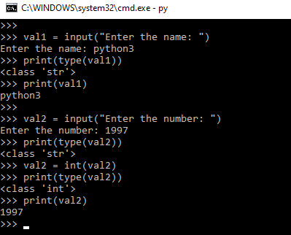
Work with raw input from users
val1 = input("Enter the name: ")
# print the type of input value
print(type(val1))
print(val1)
val2 = input("Enter the number: ")
print(type(val2))
val2 = int(val2)
print(type(val2))
print(val2)

Slide 7
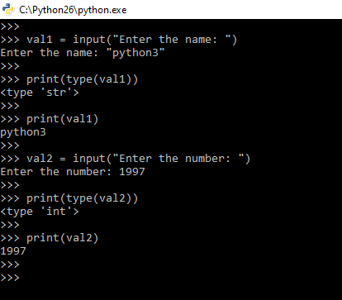
Work with raw input from users
val1 = input("Enter the name: ")
print(type(val1))
print(val1)
val2 = input("Enter the number: ")
print(type(val2))
print(val2)

Slide 8
Work with raw input from users
raw_input() function
Python raw_input function is used to get the values from the user. We call this function to tell the program to stop and wait for the user to input the values. It is a built-in function.

Slide 9
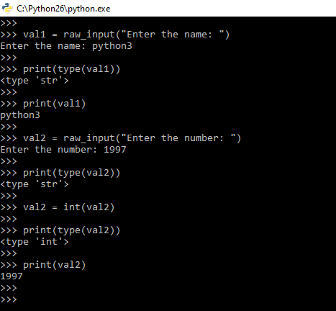
Work with raw input from users
# Python program to demonstrate
# input() function in Python2.x
val1 = raw_input("Enter the name: ")
print(type(val1))
print(val1)
val2 = raw_input("Enter the number: ")
print(type(val2))
val2 = int(val2)
print(type(val2))
print(val2)

Slide 10
Work with raw input from users
SN | input() | raw_input()
1. | input() function take the user input. | raw_input() function takes the input from the user.
2. | Its syntax is -: input(prompt) | Its syntax is -: raw_input(input)
3. | It takes only one parameter that is prompt. | It takes only one parameter that is the input.
4. | It return the input that it takes. | Its return type is of string.
5. | It converts the input into a string by removing the trailing newline | It is only introduced in python 2.0 version

Slide 11
Read and write files
Python provides inbuilt functions for creating, writing, and reading files. There are two types of files that can be handled in python, normal text files and binary files (written in binary language, 0s, and 1s)
Text files: In this type of file, Each line of text is terminated with a special character called EOL (End of Line), which is the new line character (‘\n’) in python by default.
Binary files: In this type of file, there is no terminator for a line, and the data is stored after converting it into machine-understandable binary language.

Slide 12
Read and write files - File Access Modes
Access modes govern the type of operations possible in the opened file. It refers to how the file will be used once its opened. These modes also define the location of the File Handle in the file. File handle is like a cursor, which defines from where the data has to be read or written in the file. There are 6 access modes in python.

Slide 13
Read and write files - File Access Modes
Read Only (‘r’) : Open text file for reading. The handle is positioned at the beginning of the file. If the file does not exists, raises the I/O error. This is also the default mode in which a file is opened.
Read and Write (‘r+’): Open the file for reading and writing. The handle is positioned at the beginning of the file. Raises I/O error if the file does not exist.

Slide 14
Read and write files - File Access Modes
Write Only (‘w’) : Open the file for writing. For the existing files, the data is truncated and over-written. The handle is positioned at the beginning of the file. Creates the file if the file does not exist.
Write and Read (‘w+’) : Open the file for reading and writing. For an existing file, data is truncated and over-written. The handle is positioned at the beginning of the file.

Slide 15
Read and write files - File Access Modes
Append Only (‘a’): Open the file for writing. The file is created if it does not exist. The handle is positioned at the end of the file. The data being written will be inserted at the end, after the existing data.
Append and Read (‘a+’) : Open the file for reading and writing. The file is created if it does not exist. The handle is positioned at the end of the file. The data being written will be inserted at the end, after the existing data.

Slide 16
Read and write files - Opening a File
It is done using the open() function. No module is required to be imported for this function.
File_object = open(r"File_Name","Access_Mode")
The file should exist in the same directory as the python program file else, the full address of the file should be written in place of the filename.
The r makes the string raw, that is, it tells that the string is without any special characters.
Note: The r is placed before the filename to prevent the characters in the filename string to be treated as special characters.

Slide 17
Read and write files - Opening a File
file1 is created as an object for MyFile1 and file2 as object for MyFile2
# Open function to open the file "MyFile1.txt"
# (same directory) in append mode and
file1 = open("MyFile.txt","a")
# store its reference in the variable file1
# and "MyFile2.txt" in D:\Text in file2
file2 = open(r"D:\Text\MyFile2.txt","w+")

Slide 18
Read and write files - closing a File
close() function closes the file and frees the memory space acquired by that file. It is used at the time when the file is no longer needed or if it is to be opened in a different file mode.
File_object.close()
# Opening and Closing a file "MyFile.txt"
# for object name file1.
file1 = open("MyFile.txt","a")
file1.close()

Slide 19
Read and write files - Writing to a file
There are two ways to write in a file.
write() : Inserts the string str1 in a single line in the text file.
File_object.write(str1)
writelines() : For a list of string elements, each string is inserted in the text file.Used to insert multiple strings at a single time.
File_object.writelines(L) for L = [str1, str2, str3]

Slide 20
Read and write files - Reading from a file
There are three ways to read data from a text file.
read() : Returns the read bytes in form of a string. Reads n bytes, if no n specified, reads the entire file.
File_object.read([n])
readline() : Reads a line of the file and returns in form of a string.For specified n, reads at most n bytes. However, does not reads more than one line, even if n exceeds the length of the line.
File_object.readline([n])

Slide 21
Read and write files - Reading from a file
There are three ways to read data from a text file.
read() : Returns the read bytes in form of a string. Reads n bytes, if no n specified, reads the entire file.
File_object.read([n])
readline() : Reads a line of the file and returns in form of a string.For specified n, reads at most n bytes. However, does not reads more than one line, even if n exceeds the length of the line.
File_object.readline([n])

Slide 22
Read and write files - Reading from a file
readlines() : Reads all the lines and return them as each line a string element in a list.
File_object.readlines()
Note: ‘\n’ is treated as a special character of two bytes

Slide 23
Handle File error

Slide 24
Import Local scripts

Slide 25
Reading and loading text, csv data files using python

Slide 26
Using Modules from standard library & third party

Slide 27
Debugging python code

Slide 28
Understanding packaging of python code to EXE

Slide 29
Assignments

Slide 30
Code for the presentation can be found here
Refer Readme.md of github repository for list of assignments:
https://github.com/tahirmirji/ai_with_python_keonics

Slide 31
Thank You

